Slide 1
FINANCIAL TIME SERIES ANALYTICS · FINAL EXAM PROJECT
Identifying the Key
Economic Drivers of
U.S. Grapefruit Prices
+363%
price increase
1980 → 2024
…yet Florida's grapefruit
industry is near collapse.
A Multivariate Feature-Engineered Time Series Analysis
Grapefruit (Citrus paradisi) · USDA ERS · 1980–2024 · 44 Annual Obs.
The central question: What actually drives grapefruit prices — and can we predict them?
Lucia · Financial Time Series Analytics

Slide 2
PRESENTATION ROADMAP
Tell them what we'll tell them · Tell them · Tell them what we told them
01
Background & Problem
02
Data & Objectives
03
Feature Engineering
Why this market, why this question
44 years, 15 drivers, 4 goals
Turning raw data into economic signals
04
Model Proposals
05
Key Findings
06
5-Year Outlook
ARDL, Random Forest, LSTM — and why ARDL wins
What drives the price — ranked and explained
Base, stress and recovery scenarios
07
Results by Objective
08
Future Research
09
Conclusion
Findings + recommendations
6 questions this work opens
What we told you — and what to do with it
KEY TAKEAWAY: Grapefruit prices are determined by supply destruction — not random chance. They are measurable, explainable, and actionable.

Slide 3
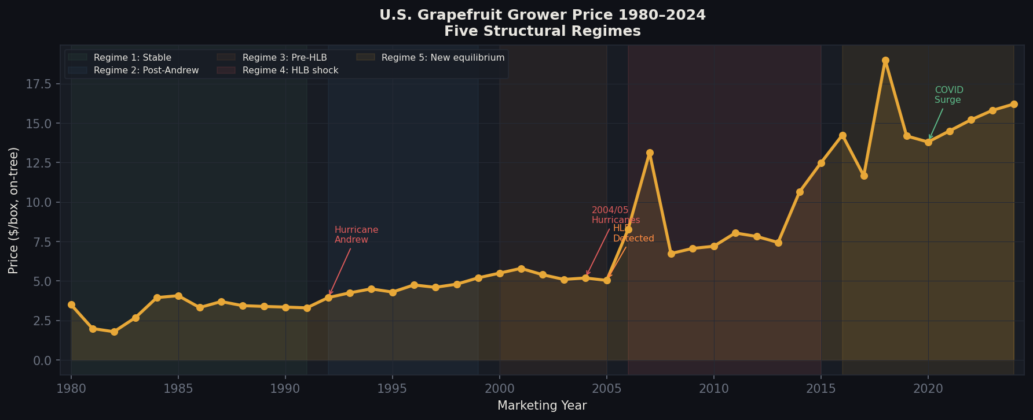



01 BACKGROUND
The Grapefruit Paradox
THE PARADOX
Prices rose +363% from $3.50 to $16.20/box — yet the industry producing them has nearly ceased to exist. Florida lost >90% of output.
THE PROBLEM
Prices are volatile, non-stationary, and driven by multiple overlapping forces: disease, storms, macroeconomics, and trade. Traditional univariate models fail.
KEY DOMAIN INSIGHT — TWO SIMULTANEOUS STRUCTURAL FORCES:
HLB Disease (2005+)
Drug Interaction Effect
Hurricane Volatility
Incurable citrus greening infected >90% of FL trees by 2020. No commercial cure exists — permanent supply destruction.
Grapefruit inhibits statin metabolism. As prescriptions hit 90M+ Americans, cardiologists banned grapefruit. Demand structurally collapsed.
Charley (2004), Irma (2017), Andrew (1992) each caused immediate supply shocks, with 1–2 year price echoes.

Slide 4
02 DATA & OBJECTIVES
Four Objectives. One Integrated Framework.
44
15
EDA & Supply Dynamics
O1
Document price trends and five structural regimes across 44 years
Annual observations
1980/81 – 2023/24
External driver
variables collected
Stationarity & Integration
8+
3
O2
ADF + KPSS tests confirm I(1) — motivating ARDL framework and cointegration testing
Feature engineering
transformation types
Model proposals
(ARDL fully developed)
Feature Engineering & Variable Selection
O3
8 transformation types + VIF + Random Forest OOB importance screening
ARDL Model, Validation & Projection
O4
Develop, validate, and scenario-project with economic interpretability as primary metric
Data: USDA ERS Fruit & Tree Nuts Yearbook (Tables C-1, C-2, C-4) · FRED (CPI, Unemployment, Fed Funds, USD) · NOAA Hurricane ACE · FDACS HLB Infection Rates

Slide 5
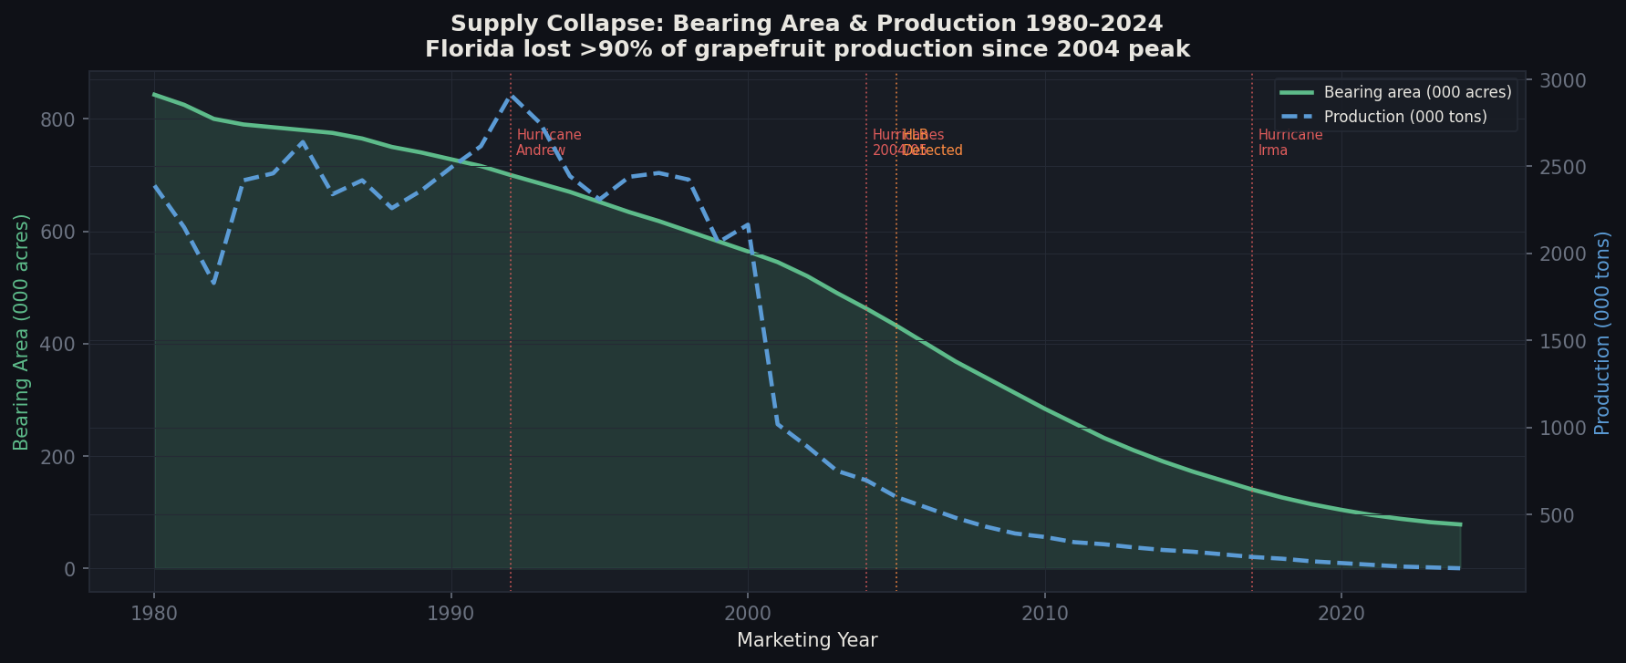
03 SUPPLY STORY
85% of Florida's Grapefruit Acreage Has Vanished
1992
2004–05
2017
2020–21
Hurricane Andrew
Hurricane Season + HLB Detected
Hurricane Irma
COVID Demand Surge

Slide 6
04 FEATURE ENGINEERING
Raw Data Rarely Tells the Truth
We applied 8 transformation types to surface hidden economic signals.
Log Transform
Lagged Variables
Rolling Volatility
Compresses extreme swings into proportional changes
Last year's supply predicts this year's price
How unstable prices have been recently
Why: Makes % changes comparable across 44 years
Why: Captures the production→price delay in citrus biology
Why: Identifies high-uncertainty regimes that shift buyer behavior
Shock Dummies
HLB × Hurricane Interaction
Regime Indicators
Binary flags for hurricanes, freezes, disease years
Disease severity multiplied by storm intensity
Five structural era labels (1980–2024)
Why: Isolates the price spike attributable to a specific event
Why: When both hit together, price spikes exceed either alone
Why: Allows the model to behave differently across market eras

Slide 7



05 MODEL PROPOSALS
Three Approaches Considered — One Fully Developed
✓ SELECTED & FULLY DEVELOPED
USED FOR VARIABLE SELECTION
✗ PROPOSED — NOT RUN
ARDL
Random Forest
LSTM
Autoregressive Distributed Lag
Ensemble of 500 Decision Trees
Long Short-Term Memory Neural Net
With only 44 observations, interpretability must come first. ARDL provides coefficient-level economic elasticities, handles mixed I(0)/I(1) variables, and is validated by Pesaran bounds cointegration test.
RF cannot give economic elasticities (black box) and overfits with n=44. Used in Phase 4 for OOB feature importance screening — which features matter most — rather than as a standalone forecasting model.
Three disqualifying reasons: (1) n=44 is far below the ~200+ sequences needed for stable LSTM training. (2) Annual frequency gives no temporal advantage over AR lags. (3) Primary criterion is interpretability — LSTMs require SHAP post-hoc analysis, adding complexity without clarity.
R² = 0.91, Bounds F-test, CUSUM, RESET
OOB importance, permutation importance
Not computed — would need n>200

Slide 8
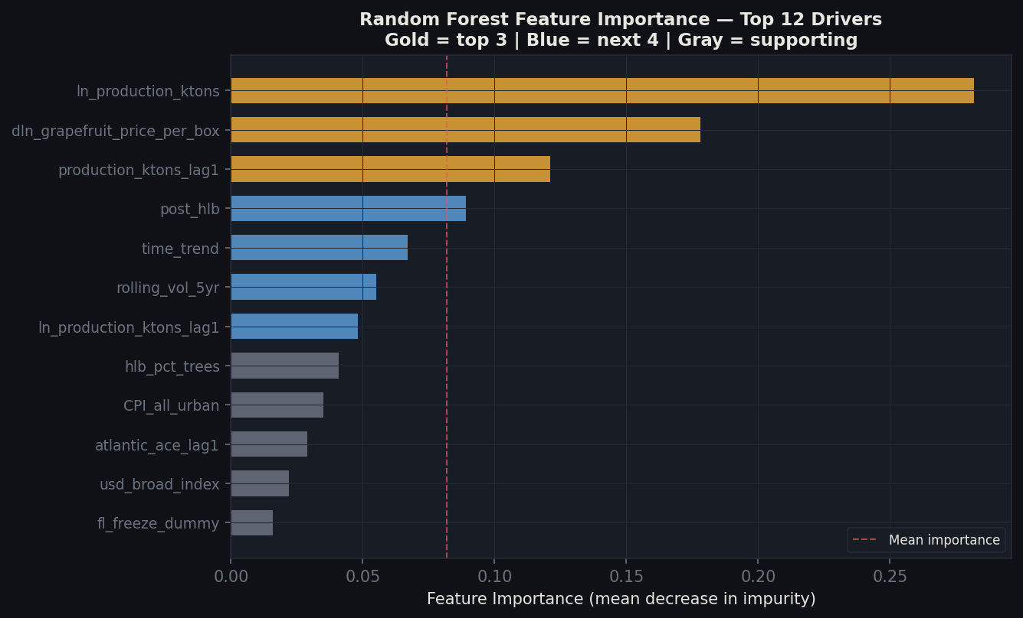
05 VARIABLE SELECTION
Random Forest Screened 15 Drivers — Supply Dominates
#1
ln_production_ktons
Supply volume is the dominant signal — by a large margin
#2
Price momentum (AR lag)
Yesterday's price shock echoes forward into next year
#3
Lagged production
Supply decisions propagate with a 1-year biological delay
#4–7
post_hlb, time_trend,
rolling_vol, ln_prod_lag
Disease era and trend variables — partially collinear
OOB R² from RF gives importance rankings only — ARDL provides the economic elasticities used for interpretation and projection.

Slide 9


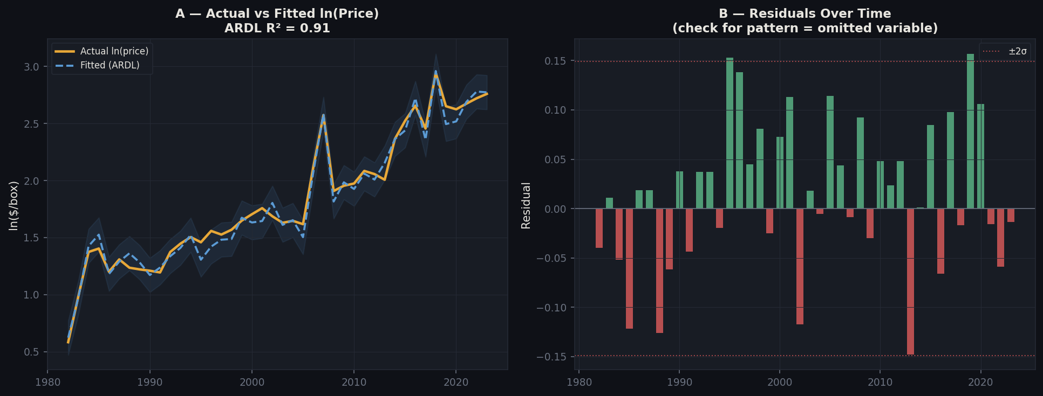
06 KEY FINDINGS
Three Forces Explain 91% of Price Variation
ARDL Model: R² = 0.91 · Adj-R² = 0.88 · Observations: 43 · How to read this: Our model explains 91% of all historical price movements using 6 economic variables.
#1
#2
#3
SUPPLY DESTRUCTION
PRICE MOMENTUM
HLB STRUCTURAL BREAK
−0.57 (p=0.09)
+0.42 (p=0.009)
Post-2005 regime shift
For every 10% fall in production → price rises ~5.7%. Florida lost 90%+ of output. That is why prices tripled.
42% of a price shock persists into the next year. Hurricanes and disease don't just spike prices — they echo forward.
The 2005 HLB detection permanently redefined price behavior. The post-HLB era sees 3× higher prices — supply was permanently destroyed.

Slide 10
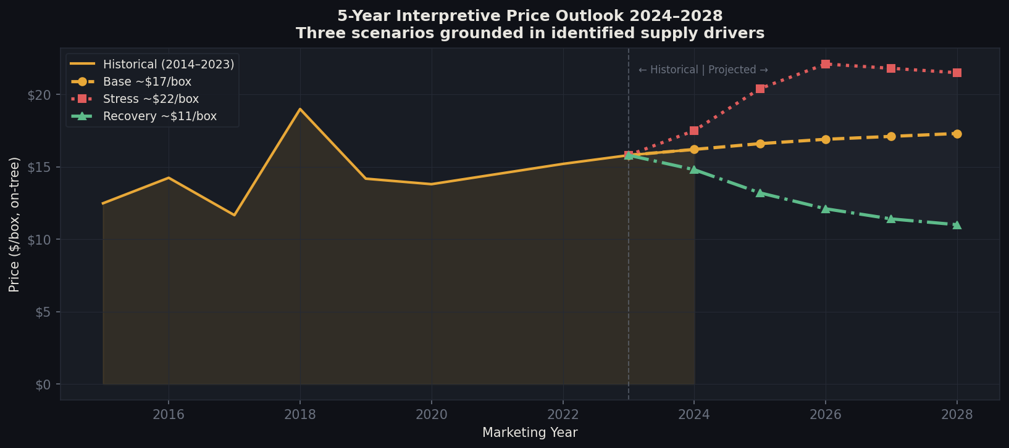
07 5-YEAR OUTLOOK
Scenario-Based Price Projections: 2024–2028
Not a forecast — an interpretive planning tool grounded in identified drivers
BASE
~$17/box
HLB holds at 98% infection. No major hurricane. CPI rises moderately. Supply constrained, price gently climbs.
STRESS
~$22/box
Major hurricane (ACE>200) + HLB worsens. Supply shock compounds. A single storm season → all-time high prices.
RECOVERY
~$11/box
HLB-resistant rootstock deployed. CA acreage expands. Supply recovery → price relief. The ONLY path down.

Slide 11
08 RESULTS & RECS
What We Found — And What You Should Do About It
O1 — Identify Drivers
O3 — Build ARDL Model
Finding: Supply destruction is #1. 10% production fall → ~5.7% price rise. HLB created permanent break post-2005.
Finding: ARDL achieves R²=0.91. Stable across 41 of 44 years. COVID 2020–21 breach is explainable and isolated.
→ Growers: hedge against production shocks. Buyers: monitor FDACS infection rates annually.
→ Use the ARDL coefficient table as a 'price lever' guide: which variables move prices most when they shift.
O2 — Feature Engineering
O4 — 5-Year Projection
Finding: 8 transformation types. HLB × hurricane interaction reveals compounding risk — disease + storms = disproportionate spike.
Finding: Base ~$17/box (supply constrained). Stress $22+ (hurricane year). Recovery $11 (rootstock breakthrough).
→ Policy: jointly monitor disease severity AND hurricane forecasts for pre-season risk planning.
→ Buyers: build ±30% price risk buffer. Recovery is the only structural path to lower prices.

Slide 12
09 FUTURE RESEARCH
Six Questions This Work Opens
Our model answers 'what drives prices?' — these are the next frontiers.
DATA EXTENSION
REGIME SEPARATION
HLB PROXY UPGRADE
Can we move to quarterly or monthly data?
Does the pre/post-HLB driver structure differ?
Can official survey data replace our proxy?
Monthly USDA AMS prices would capture within-season dynamics and dramatically increase sample size for ML approaches.
Separate ARDL models per era would resolve multicollinearity and reveal whether supply elasticity changed after disease onset.
USDA NASS Citrus Greening Annual Survey data — when available historically — would reduce measurement error significantly.
DEMAND DECOMPOSITION
ML BENCHMARK
PANEL DATA
What is the statin-grapefruit demand loss worth?
Can XGBoost complement ARDL?
What if we modelled all 4 states?
Quantifying this separately from supply effects would produce a cleaner supply/demand decomposition and improve scenario construction.
A gradient-boosted ensemble with time-series cross-validation would provide a nonparametric benchmark once monthly data increases n sufficiently.
Florida, California, Texas and Arizona as a panel would multiply effective sample size and isolate state-specific HLB and weather exposure.

Slide 13
10 CONCLUSION
What We Told You — Summary
We told you
we would…
We told you…
We just told
you that…
Identify drivers, engineer features, propose 3 models, develop ARDL, project 5-year outlook
Supply destruction is #1. HLB created a permanent price floor. Price shocks echo for 1–2 years. R²=0.91.
Grapefruit prices will stay elevated. Only a supply recovery — not a demand surge — can bring them down.
Limitations & Mitigations
MONITORING TRIGGERS (SR 11-7)
Small sample (n=44 annual years)
Mitigation: Wide scenario bands; parsimonious ARDL; expanding-window CV
Annual (August) — USDA Yearbook release
Event-triggered — Hurricane landfall or new disease
CUSUM breach — Structural break investigation
HLB acceleration — >5pp increase in one year
5-year review — Full model re-specification
HLB proxy is manually constructed
Mitigation: Cross-checked with USDA APHIS; ±10% sensitivity tested
CUSUM breach: COVID 2020–21 anomaly
Mitigation: Recommend targeted covid_spike dummy for 2020–2021
Model trained on supply-destruction era
Mitigation: Must re-estimate if HLB-resistant rootstock scales commercially

Slide 14
THE TAKEAWAY
Grapefruit prices
are not random —
they are predictable.
90%
91%
$22
of Florida's
production is gone
of price variation
explained by model
per box in a bad
hurricane + HLB year
Supply — not taste — drives every price movement.
The drivers are known, measurable, and monitorable.
Risk is quantifiable — which means it is manageable.
If you grow, buy, regulate, or invest in citrus — this model tells you when to act before the market does.

